Slide 2
SQL

Slide 3
What is Database
A database is an organized collection of data, so that it can be easily accessed and managed.
You can organize data into tables, rows, columns, and index it to make it easier to find relevant information.
Database handlers create a database in such a way that only one set of software program provides access of data to all the users.
The main purpose of the database is to operate a large amount of information by storing, retrieving, and managing data.
There are many dynamic websites on the World Wide Web nowadays which are handled through databases. For example, a model that checks the availability of rooms in a hotel. It is an example of a dynamic website that uses a database.
There are many databases available like MySQL, Sybase, Oracle, MongoDB, Informix, PostgreSQL, SQL Server, etc.
Modern databases are managed by the database management system (DBMS).

Slide 4
Set up my sql
MySQL is one of the most popular relational database management software that is widely used in today's industry. It provides multi-user access support with various storage engines
Step 1: Go to the official website of MySQL and download the community server edition software. Here, you will see the option to choose the Operating System, such as Windows.
Step 2: Next, there are two options available to download the setup. Choose the version number for the MySQL community server, which you want. If you have good internet connectivity, then choose the mysql-installer-web-community. Otherwise, choose the other one.

Slide 5
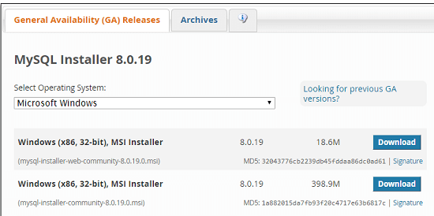
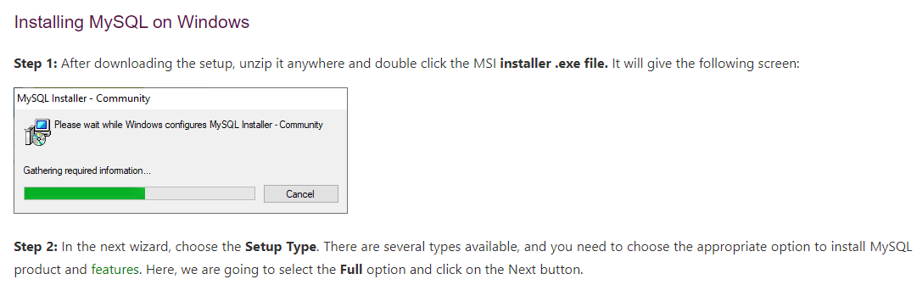
Set up my sql continued

Slide 6
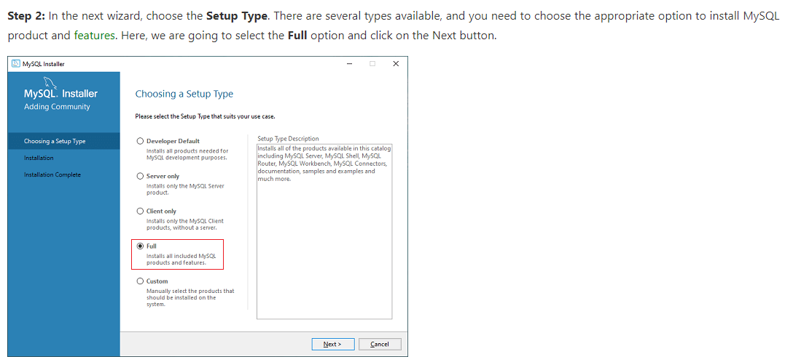
Set up my sql continued

Slide 7
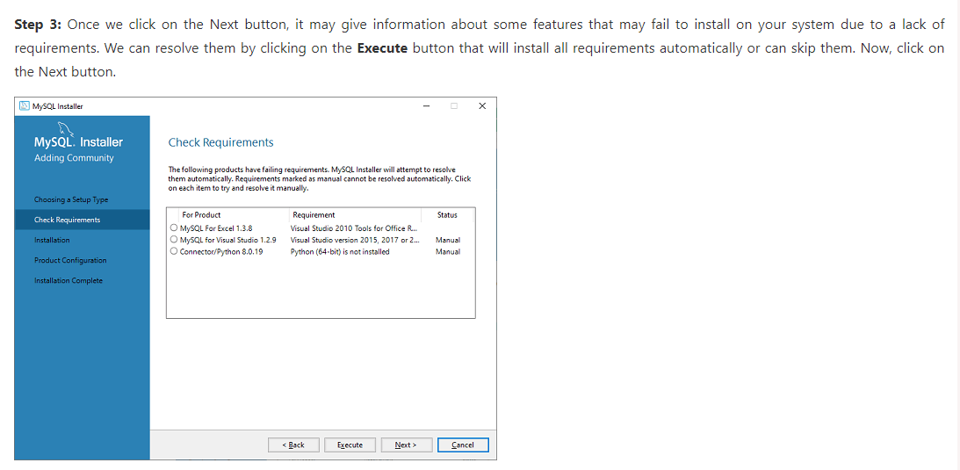
Set up my sql

Slide 8
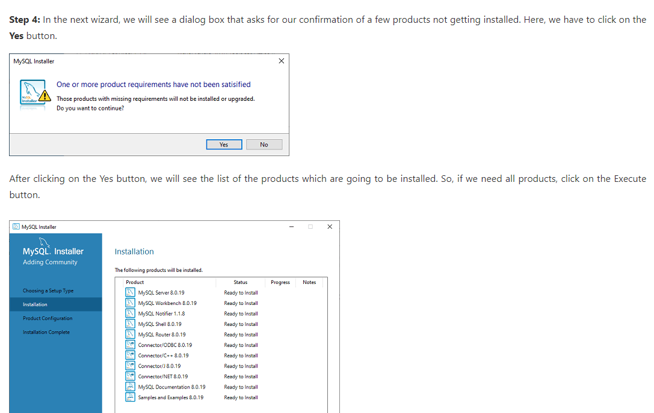
Set up my sql

Slide 9
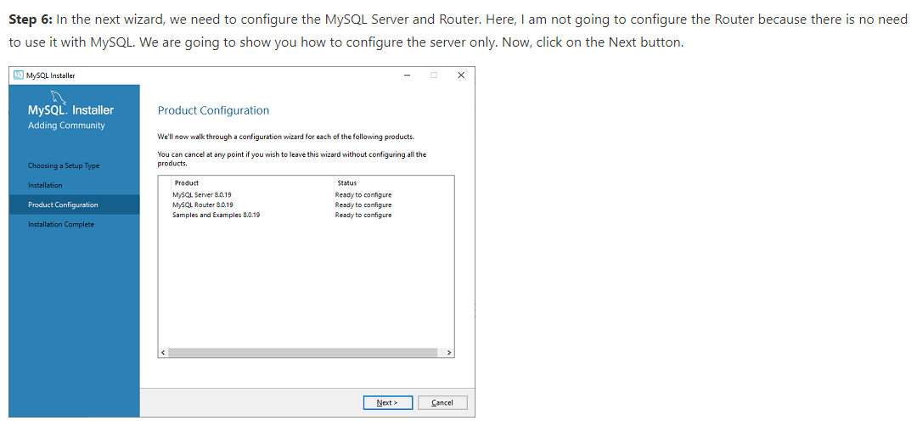
Set up my sql(continued)

Slide 10
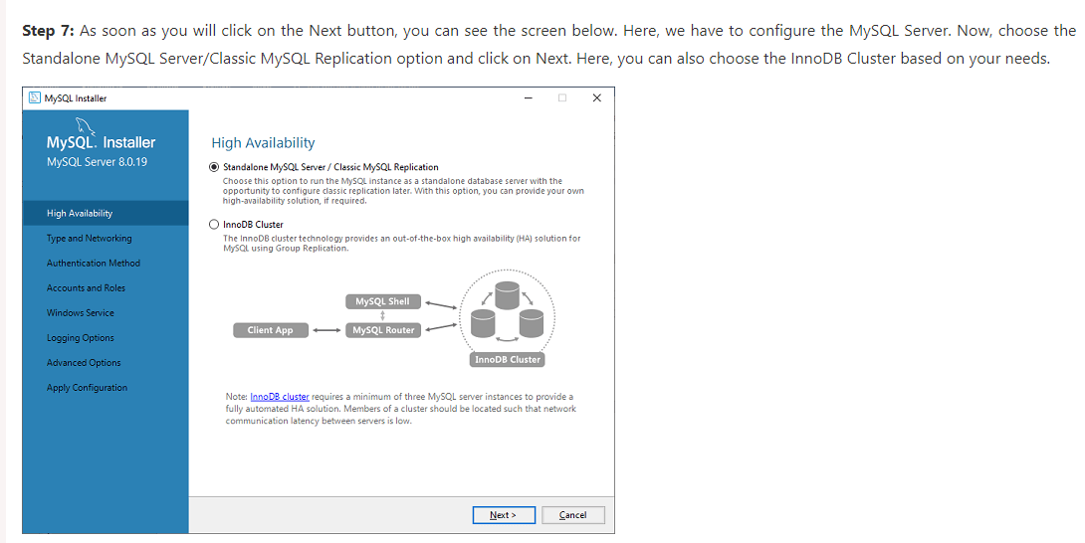
Set up my sql(continued)

Slide 11
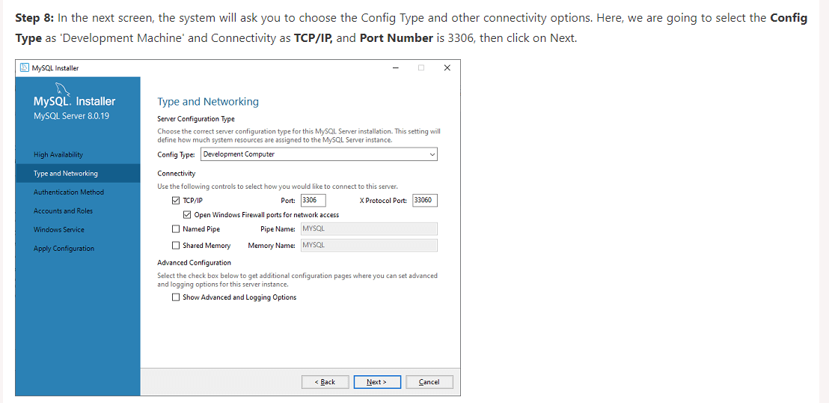
Set up my sql(continued)

Slide 12
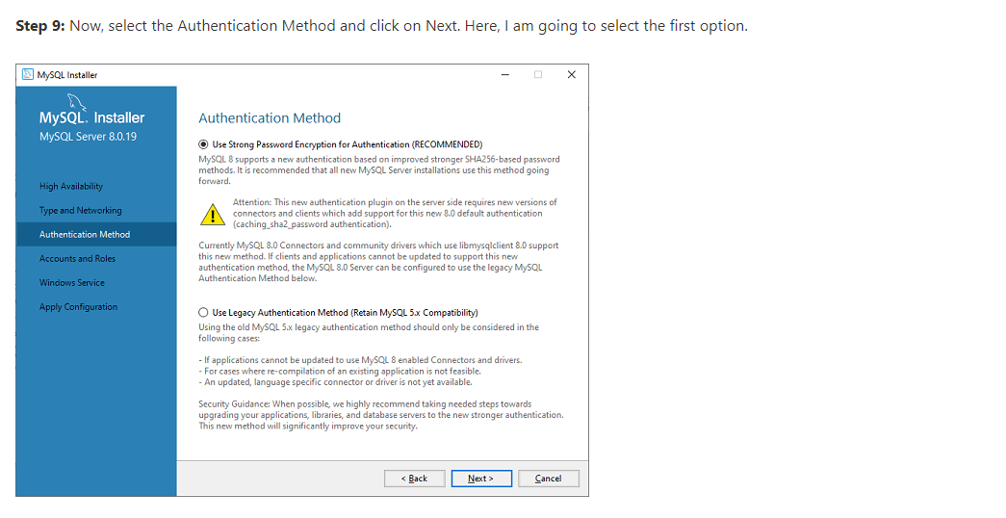
Set up my sql(continued)

Slide 13
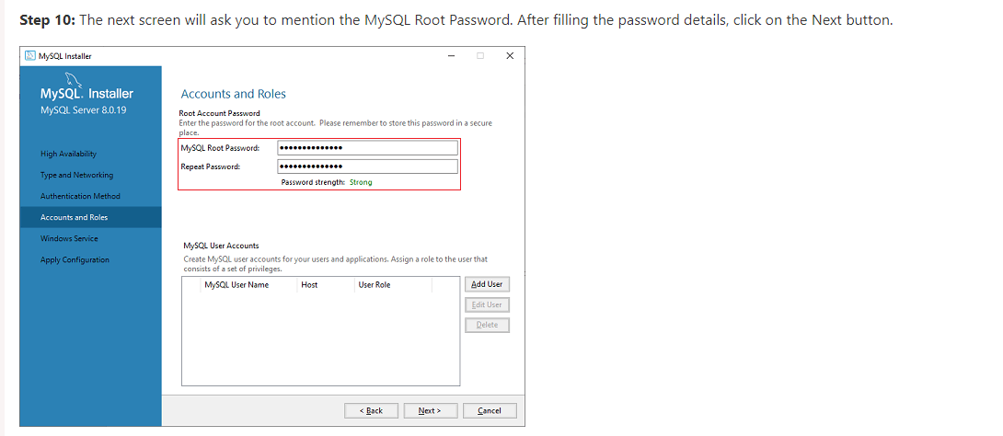
Set up my sql(continued)

Slide 14
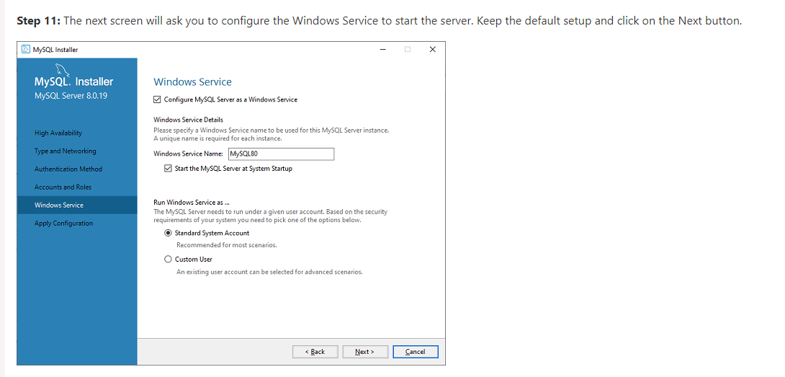
Set up my sql(continued)

Slide 15
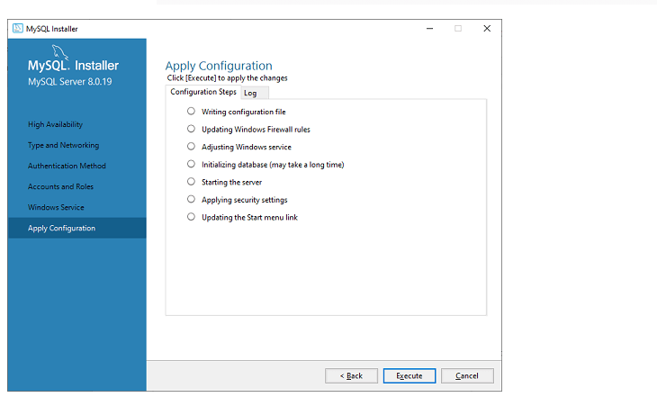
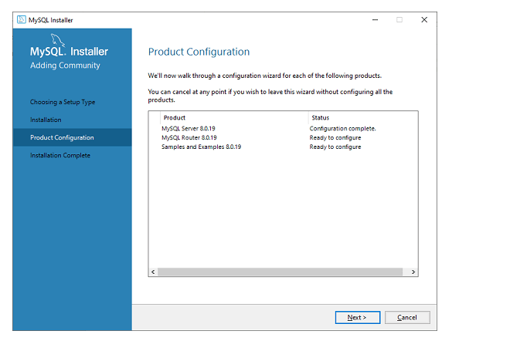
Set up my sql(continued)

Slide 16
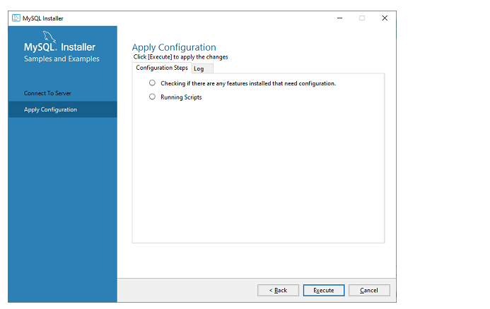
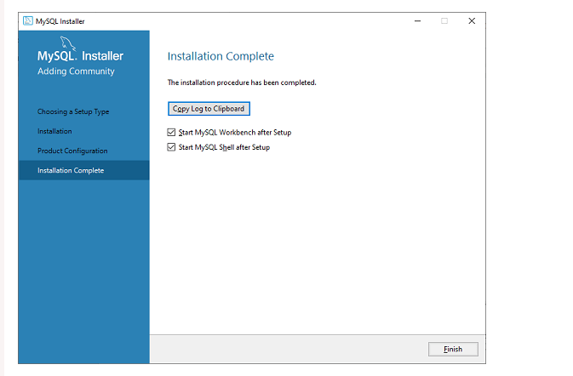
Set up my sql(continued)

Slide 17
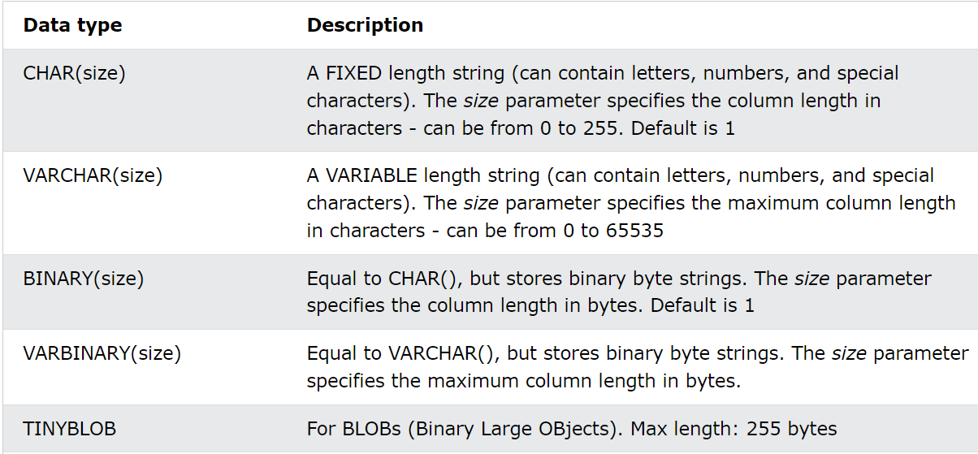
Data types in MY SQL
Each column in a database table is required to have a name and a data type.
An SQL developer must decide what type of data that will be stored inside each column when creating a table. The data type is a guideline for SQL to understand what type of data is expected inside of each column, and it also identifies how SQL will interact with the stored data.

Slide 18
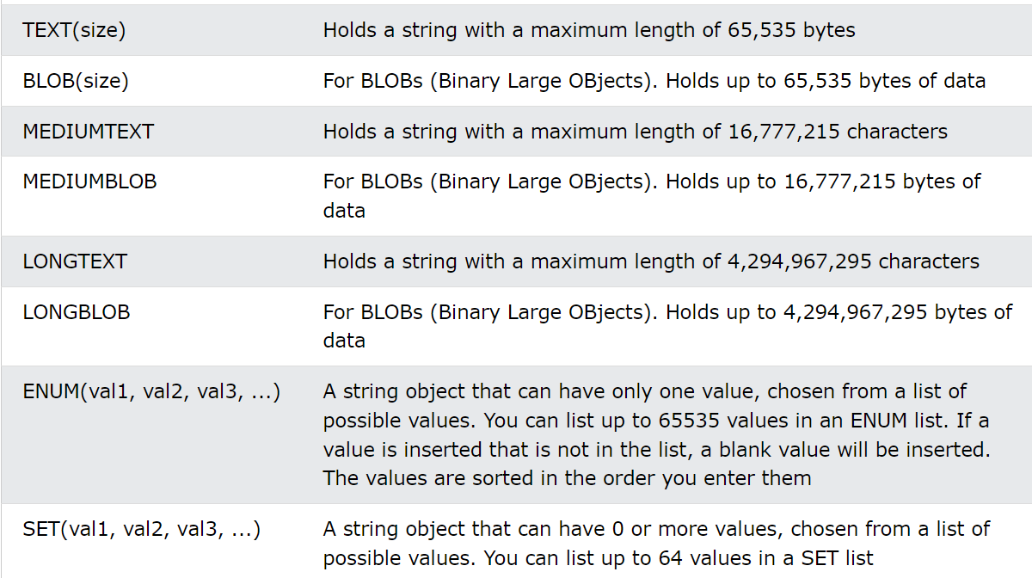
Data Types in MYSQL(continued)

Slide 19
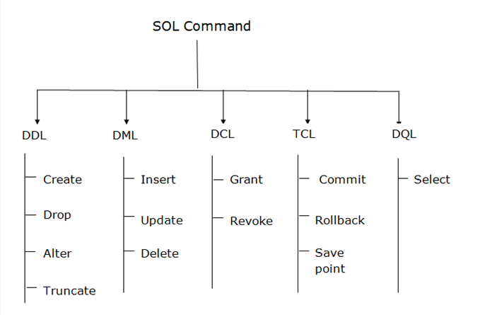
SQL CommANDS AND TYPES
SQL commands are instructions. It is used to communicate with the database. It is also used to perform specific tasks, functions, and queries of data.
SQL can perform various tasks like create a table, add data to tables, drop the table, modify the table, set permission for users.

Slide 20
Data Definition Language
DDL changes the structure of the table like creating a table, deleting a table, altering a table, etc.
All the command of DDL are auto-committed that means it permanently save all the changes in the database.
DDL is a set of SQL commands used to create, modify, and delete database structures but not data. These commands are normally not used by a general user, who should be accessing the database via an application.
Here are some commands that come under DDL:
CREATE
ALTER
DROP
TRUNCATE

Slide 21
Create ,Alter Commands
CREATE
It is used to create a new table in the database.
This command is used to create the database or its objects (like table, index, function, views, store procedure, and triggers).
Syntax:
CREATE TABLE TABLE_NAME (COLUMN_NAME DATATYPES[,....]);
ALTER:
This is used to alter the structure of the database.
. It is used to alter the structure of the database. This change could be either to modify the characteristics of an existing attribute or probably to add a new attribute.
Syntax:
To add a new column in the table
ALTER TABLE table_name ADD column_name COLUMN-definition;

Slide 22
Drop and Truncate
DROP:
It is used to delete both the structure and record stored in the table.
Syntax
DROP TABLE table_name;
Example
DROP TABLE EMPLOYEE;
TRUNCATE
It is used to delete all the rows from the table and free the space containing the table.
Syntax:
TRUNCATE TABLE table_name;
Example:
TRUNCATE TABLE EMPLOYEE;

Slide 23
DML Commands
The SQL commands that deal with the manipulation of data present in the database belong to DML or Data Manipulation Language and this includes most of the SQL statements. It is the component of the SQL statement that controls access to data and to the database. Basically, DCL statements are grouped with DML statements.
List of DML commands:
INSERT: It is used to insert data into a table.
UPDATE: It is used to update existing data within a table.
DELETE: It is used to delete records from a database table.

Slide 24
Insert commands
The INSERT statement is a SQL query. It is used to insert data into the row of a table.
Syntax:
INSERT INTO TABLE_NAME
(col1, col2, col3,.... col N)
VALUES (value1, value2, value3, .... valueN);
ment is a SQL query. It is used to insert data into the row of a table.
INSERT INTO javatpoint (Author, Subject) VALUES ("Sonoo", "DBMS");
INSERT INTO TABLE_NAME
VALUES (value1, value2, value3, .... valueN);

Slide 25
Update command
This command is used to update or modify the value of a column in the table.
It is used to update existing data within a table.
Syntax:
UPDATE table_name SET [column_name1= value1,...column_nameN = valueN] [WHERE CONDITION]
For example:
UPDATE students
SET User_Name = 'Sonoo'
WHERE Student_Id = '3'

Slide 26
Delete command
It is used to remove one or more row from a table.
It is used to delete records from a database table.
Syntax:
DELETE FROM table_name [WHERE condition];
For example:
DELETE FROM javatpoint
WHERE Author="Sonoo";

Slide 27
Data control language
DCL commands are used to grant and take back authority from any database user.
DCL includes commands such as GRANT and REVOKE which mainly deal with the rights, permissions, and other controls of the database system.
GRANT: This command gives users access privileges to the database.
Syntax:
GRANT SELECT, UPDATE ON MY_TABLE TO SOME_USER, ANOTHER_USER;
REVOKE:
This command withdraws the user’s access privileges given by using the GRANT command.
Syntax:
REVOKE SELECT, UPDATE ON MY_TABLE FROM USER1, USER2;

Slide 28
Transaction control language
Transactions group a set of tasks into a single execution unit. Each transaction begins with a specific task and ends when all the tasks in the group successfully complete. If any of the tasks fail, the transaction fails. Therefore, a transaction has only two results: success or failure. You can explore more about transactions here. Hence, the following TCL commands BEGIN: Opens a Transaction.
COMMIT: Commits a Transaction.
Syntax:
COMMIT;
ROLLBACK: Rollbacks a transaction in case of any error occurs.
Syntax:
ROLLBACK;
SAVEPOINT: Sets a save point within a transaction.
Syntax:
SAVEPOINT SAVEPOINT_NAME;are used to control the execution of a transaction:

Slide 29
Data query language
DQL is used to fetch the data from the database.
It uses only one command:
SELECT : This is the same as the projection operation of relational algebra. It is used to select the attribute based on the condition described by WHERE clause.
Syntax:
SELECT expressions
FROM TABLES
WHERE conditions;
For example:
SELECT emp_name
FROM employee
WHERE age > 20;

Slide 30
How to Create Constraints in MYSQL
We can define the constraints during a table created by using the CREATE TABLE statement. MySQL also uses the ALTER TABLE statement to specify the constraints in the case of the existing table schema.
Syntax
The following are the syntax to create a constraints in table:
CREATE TABLE new_table_name (
col_name1 datatype constraint,
col_name2 datatype constraint,
col_name3 datatype constraint,
.........
);

Slide 31
Constraints used in MySQL
Constraints used in MySQL
The following are the most common constraints used in the MySQL:
NOT NULL
CHECK
PRIMARY KEY
UNIQUE
INDEX

Slide 32
How to Create Constraints in MYSQL
We can define the constraints during a table created by using the CREATE TABLE statement. MySQL also uses the ALTER TABLE statement to specify the constraints in the case of the existing table schema.
Syntax
The following are the syntax to create a constraints in table:
CREATE TABLE new_table_name (
col_name1 datatype constraint,
col_name2 datatype constraint,
col_name3 datatype constraint,
.........
);

Slide 33
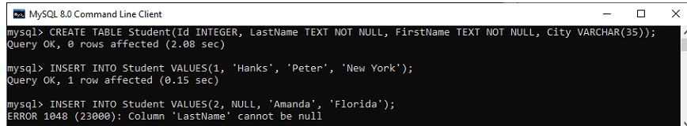
Not Null Constraints
This constraint specifies that the column cannot have NULL or empty values. The below statement creates a table with NOT NULL constraint.
CREATE TABLE Student(Id INTEGER, LastName TEXT NOT NULL, FirstName TEXT NOT NULL, City VARCHAR(35));
INSERT INTO Student VALUES(1, 'Hanks', 'Peter', 'New York');
INSERT INTO Student VALUES(2, NULL, 'Amanda', 'Florida');
In the above image, we can see that the first INSERT query executes correctly, but the second statement fails and gives an error that says column LastName cannot be null.

Slide 34
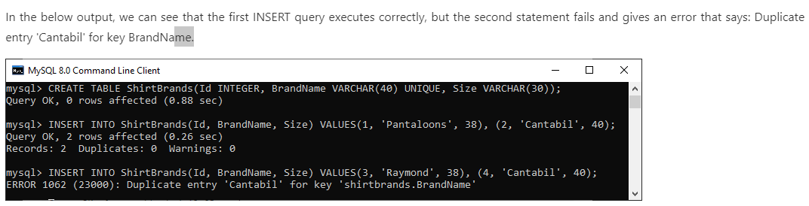
Unique constraints
This constraint ensures that all values inserted into the column will be unique. It means a column cannot stores duplicate values. MySQL allows us to use more than one column with UNIQUE constraint in a table. The below statement creates a table with a UNIQUE constraint:
mysql> CREATE TABLE ShirtBrands(Id INTEGER, BrandName VARCHAR(40) UNIQUE, Size VARCHAR(30));
mysql> INSERT INTO ShirtBrands(Id, BrandName, Size) VALUES(1, 'Pantaloons', 38), (2, 'Cantabil', 40);
mysql> INSERT INTO ShirtBrands(Id, BrandName, Size) VALUES(1, 'Raymond', 38), (2, 'Cantabil', 40);

Slide 35
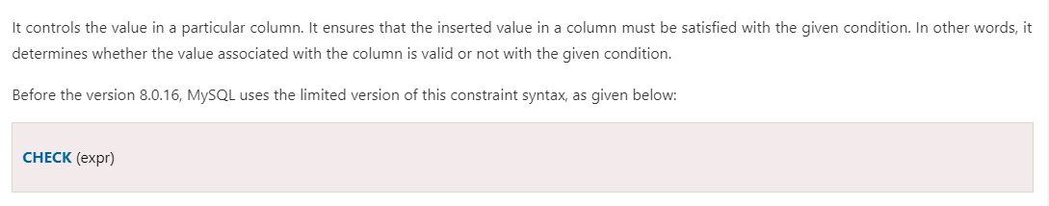
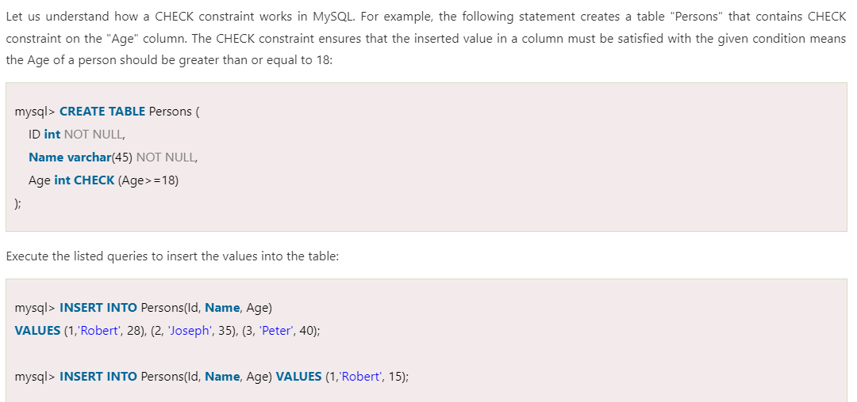
Check constraints

Slide 36
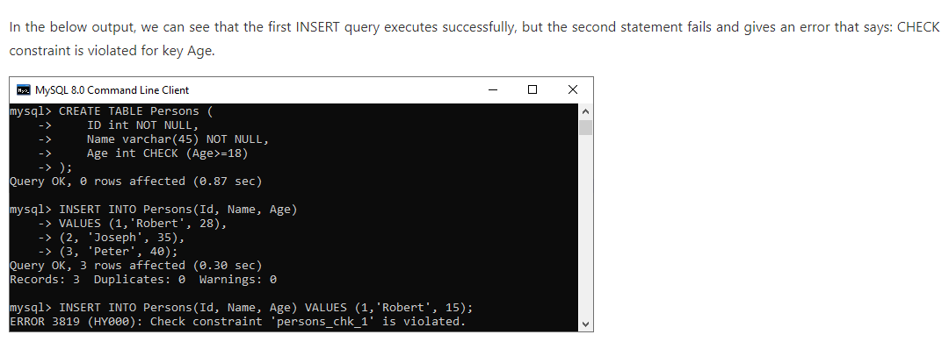
Check Constraints (Continued)

Slide 37
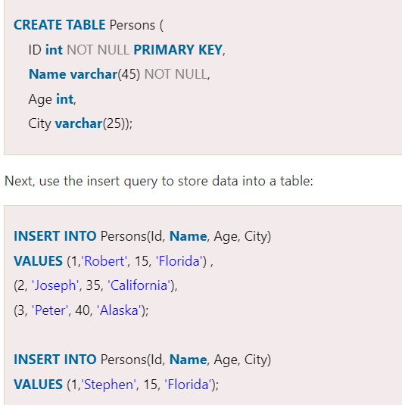
Primary key constraint
This constraint is used to identify each record in a table uniquely. If the column contains primary key constraints, then it cannot be null or empty. A table may have duplicate columns, but it can contain only one primary key. It always contains unique value into a column.

Slide 38
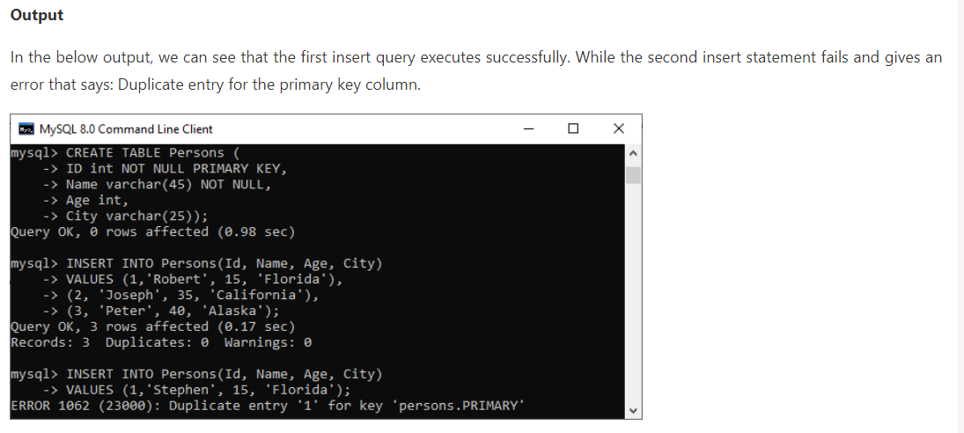
Primary key constraint(continued)

